Slide 1
Weekly report: Foundations
Week number: 11
Date: 09/12/2025
Supervisor: Prof. Dr.-Ing. Torsten Faber
Group members : Jehad Albaali- Amgad Gerges - Reda Deif
presented by : Jehad Albaali

Slide 2
List of contents
Reasons for Design Pedestal
Bolt Tension Verification
Reinforcement Details
Complete Foundation Cost Breakdown
References
Jehad Albaali
Foundations team/ Optimus Syria

Slide 3
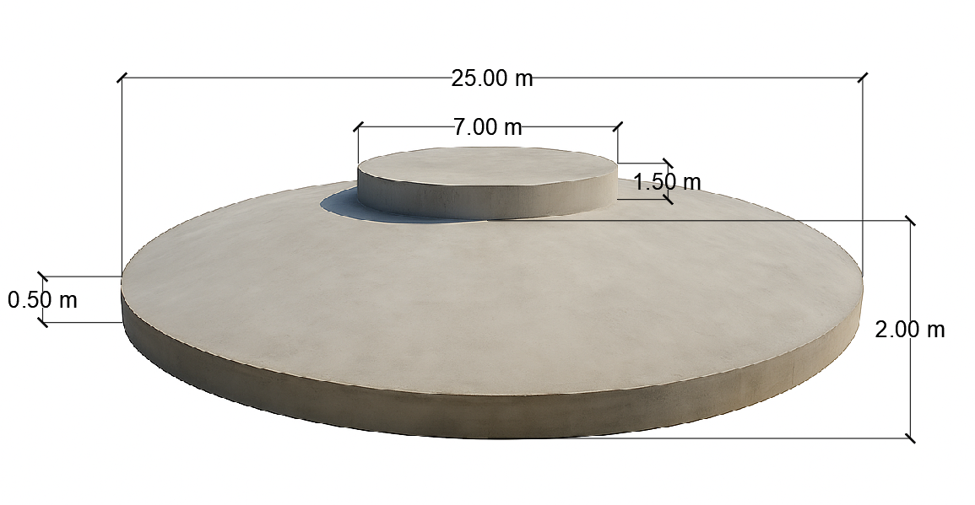
Concrete Dimensions
Diameter of Base Plate (BP) = 25 m
Diameter of Pedestal = 7 m
Height Pedestal = 1.5 m
Height of Middle slab = 2 m
Height of Frustum (HF) = 1.5 m
Height of Edge slab (HE) = 0.5 m
Jehad Albaali
Foundations team/ Optimus Syria

Slide 4
Reasons for Design Pedestal
Improved load transfer from the tower to the foundation
Strengthening the critical upper concrete zone and enhancing cone-shear resistance
Better bending-moment distribution and reduced structural deformations
Higher pull-out capacity and confinement for anchor bolts
Enhancing anchor-cage performance and increasing its structural safety margin
High-precision tower alignment (±2 mm per IEC).
Safe and efficient installation workspace for anchor cage & bolt tensioning.
Jehad Albaali
Foundations team/ Optimus Syria

Slide 5
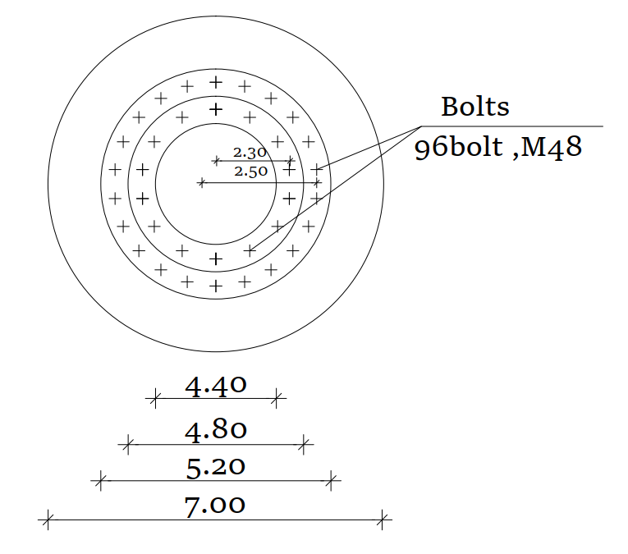
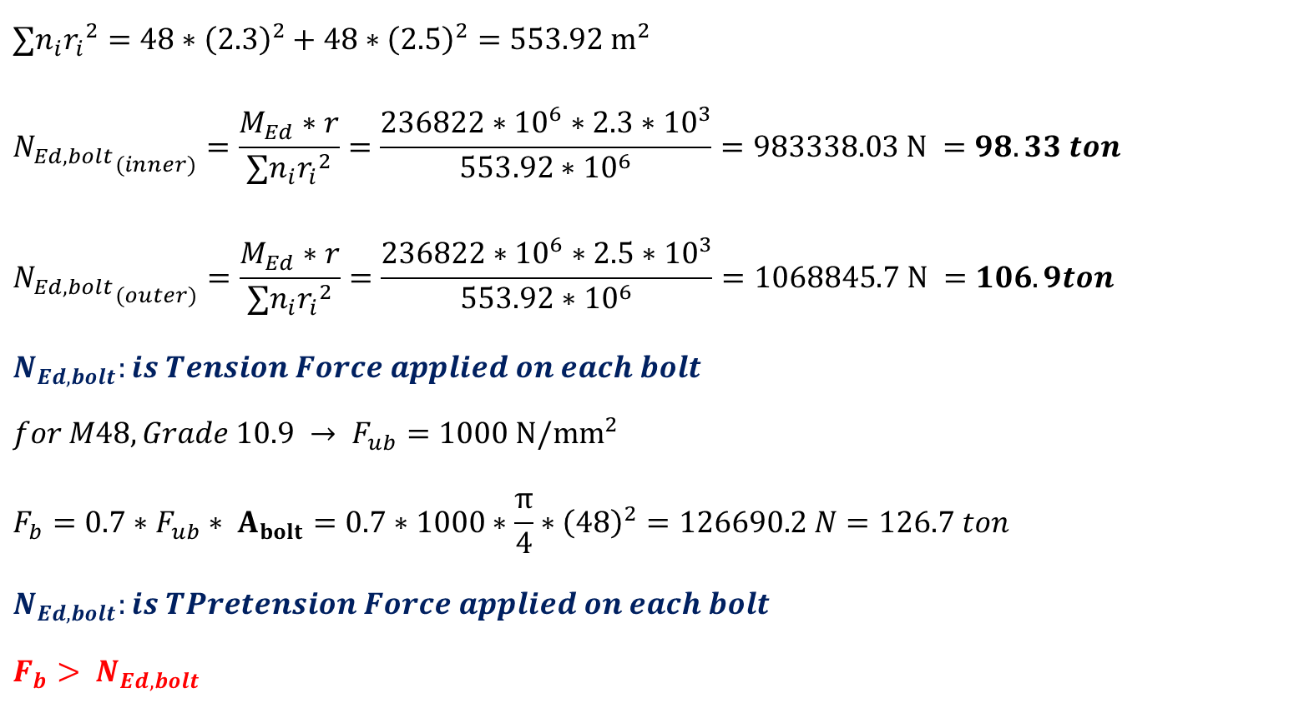
Bolt Tension Verification
$$∑n_{i}{r_{i}}^{2}=48∗{\left(2.3\right)}^{2}+48∗{\left(2.5\right)}^{2}=553.92 m^{2}$$
$${N_{Ed,bolt}}_{(inner)}=\frac{M_{Ed}∗r}{∑n_{i}{r_{i}}^{2}}=\frac{236822∗{10}^{6}∗2.3∗{10}^{3}}{553.92∗{10}^{6}}=983338.03 N =98.33 ton$$
$${N_{Ed,bolt}}_{(outer)}=\frac{M_{Ed}∗r}{∑n_{i}{r_{i}}^{2}}=\frac{236822∗{10}^{6}∗2.5∗{10}^{3}}{553.92∗{10}^{6}}=1068845.7 N =106.9ton$$
$$N_{Ed,bolt}:is Tension Force applied on each bolt$$
$$for M48,Grade 10.9 → F_{ub}=1000 N/{mm}^{2}$$
$$F_{b}=0.7∗F_{ub}∗ A_{bolt}=0.7∗1000∗\frac{π}{4}∗{\left(48\right)}^{2}=126690.2 N=126.7 ton$$
$$N_{Ed,bolt}:is TPretension Force applied on each bolt$$
$$F_{b}> N_{Ed,bolt}$$
Jehad Albaali
Foundations team/ Optimus Syria

Slide 6
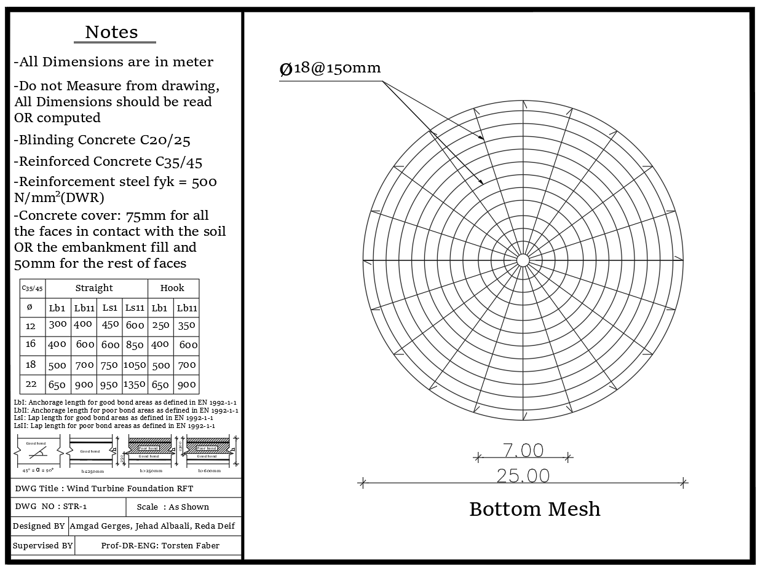
Reinforcement Details
Figure created by the author (AutoCAD, 2025)
Jehad Albaali
Foundations team/ Optimus Syria

Slide 7
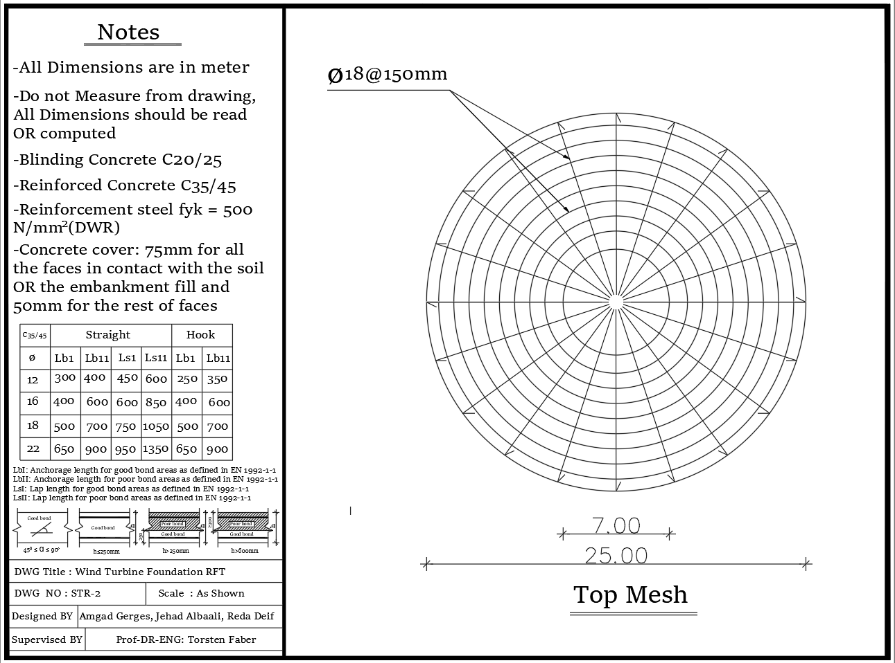
Reinforcement Details
Figure created by the author (AutoCAD, 2025)
Jehad Albaali
Foundations team/ Optimus Syria

Slide 8
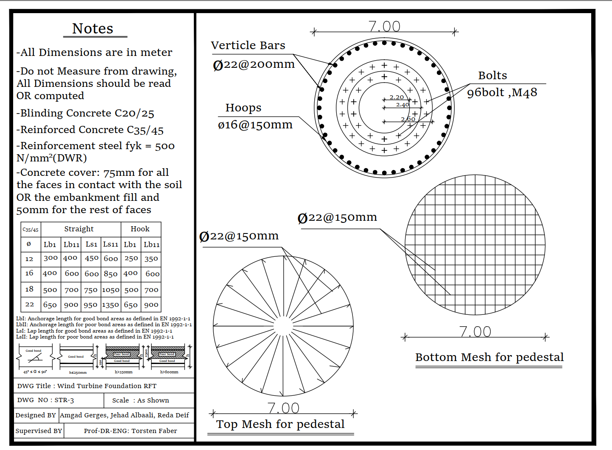
Reinforcement Details
Figure created by the author (AutoCAD, 2025)
Jehad Albaali
Foundations team/ Optimus Syria

Slide 9
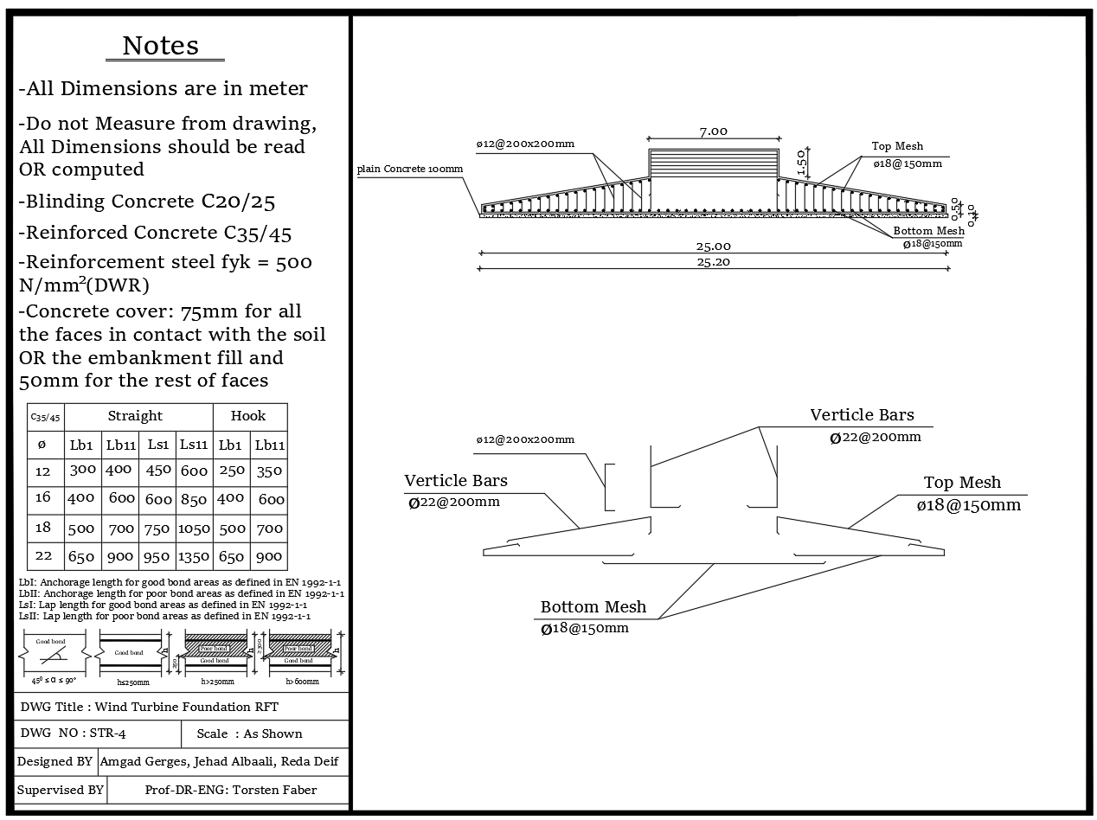
Reinforcement Details
Figure created by the author (AutoCAD, 2025)
Jehad Albaali
Foundations team/ Optimus Syria

Slide 10
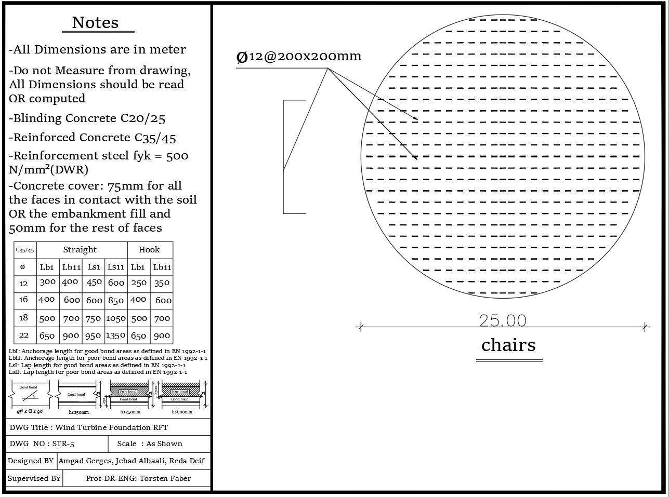
Reinforcement Details
Figure created by the author (AutoCAD, 2025)
Jehad Albaali
Foundations team/ Optimus Syria

Slide 11
Complete Foundation Cost Breakdown
Foundation Specifications
Unit Pricing Structure
Concrete volume: 1,121 m³
Concrete + labor + formwork: €182/m²
Reinforcement steel: 49.4 tons
Reinforcement steel: €595/ton
Anchor bolt cage: 4.0 tons
Anchor bolts: €2,273/ton
Grout volume: 0.54 m³
Grout materials: €727/m³
Total foundation area: 491 m²
Detailed Cost Calculations
Anchor Bolt Cage
Concrete & Labor
Specialized anchor system weighing 4.0 tons to secure the turbine tower to the foundation.
Includes all concrete materials, labor costs, and formwork installation for the 491 m² foundation area.
Grout Materials
Reinforcement Steel
High-strength grout for final anchor bolt installation and load distribution.
Total cost for 49.4 tons of reinforcement steel required for structural integrity.
€128,240
€261
Total Foundation Cost
Cost per Square Meter
Complete construction cost including all materials and labor
Average cost per m² of foundation area (128,240 ÷ 491)
Jehad Albaali
Foundations team/ Optimus Syria

Slide 12
References
IEC 61400-6: Wind Turbines – Tower and Foundation Design Requirements, IEC (2020).
EN 1992-1-1: Eurocode 2 – Design of Concrete Structures, CEN.
EN 1993-1-8: Eurocode 3 – Design of Steel Structures, CEN.
Bautabellen für Ingenieure ( mit Berechnungshinweisen und Beispielen )
Jehad Albaali
Foundations team/ Optimus Syria

